Slide 1

Evaluation of Personalized Summarization
Presented By: Rahul Vansh (202111035)
Thesis Guide: Prof. Sourish Dasgupta

Slide 2
Outline
Stage-1 recap
Evaluation of degree of personalization in Summarizers
Problem statement
State-of-the-art summarization evaluation (accuracy-centric)
Accuracy-centric measures vs. Personalization-centric measure
Designing evaluation measure
e-DINS w.r.t subjectivity
Experimental Setup
Dataset
Computing e-D-INS using human gold reference summaries (from PENS test dataset)
Handling Out-Of-Vocabulary words in reference summaries
Degree of personalization of SOTA personalized summarizers
Reliability of e-DINS as a degree of personalization measure
Future work : Work in progress
Notes:
Things that we are focusing on

Slide 3
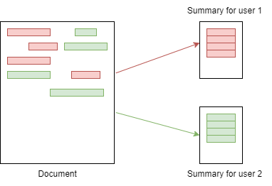
Stage-1 recap: Why personalization?
Is reader interested in the information presented in a summary?
Personalized summarization considers user’s attention/ interest to generate summary [3]
Notes:
salient = imp info
Static summary

Slide 4
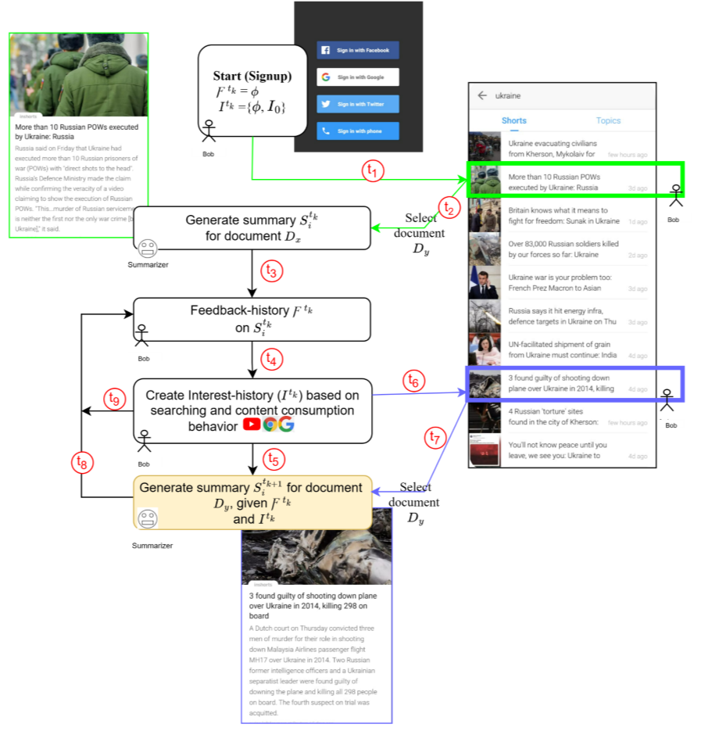
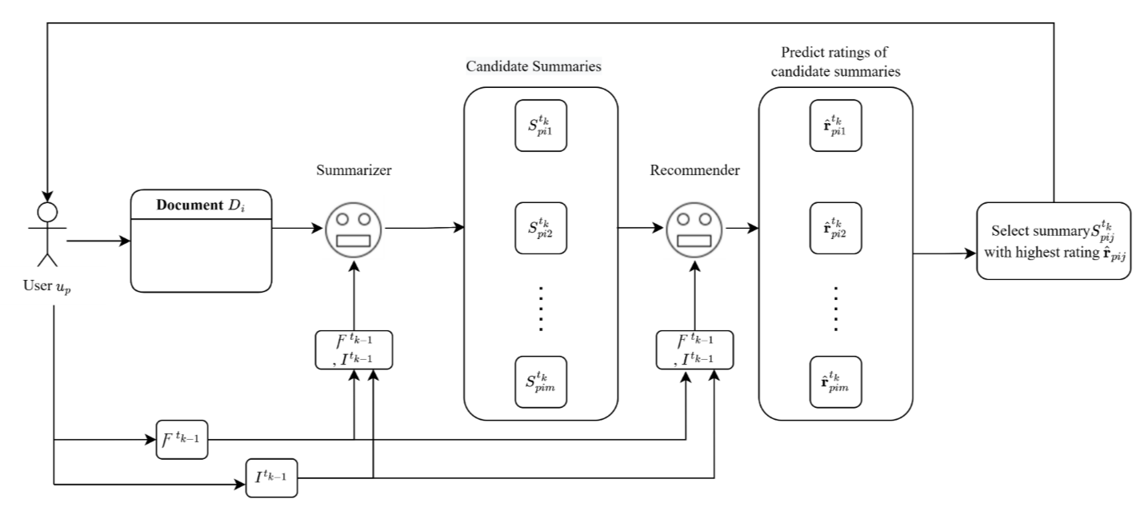
Stage-1 recap
Adaptive Summarization as Personalized Summary Recommendation
To what extent model is personalized? - so far, no measure

Slide 5
Evaluation of degree of personalization

Slide 6
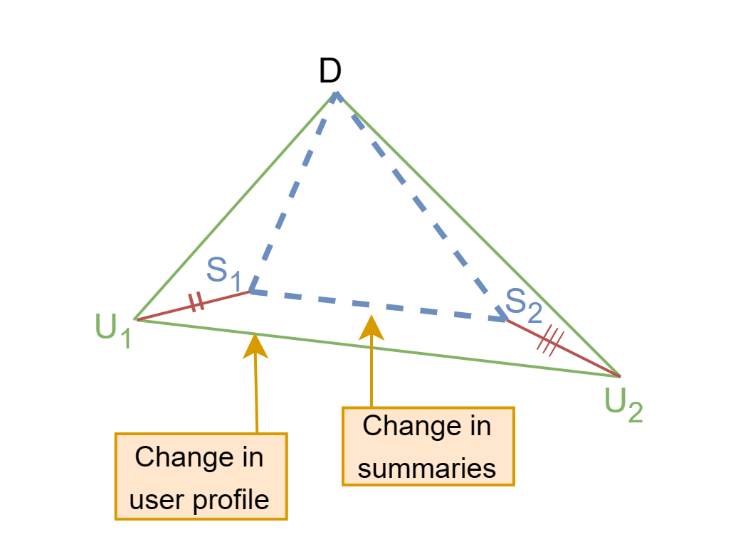
Problem Statement
Degree of personalization indicates how well model adapts to the user's preferences while generating a summary for the user.
In order to accurately measure it, proportional changes to both user profiles and summaries must be considered.
Notes:
Things that we are focusing on

Slide 7
Evaluation framework: Research Motivation
There are several metrics that evaluate model in terms of accuracy and quality (focuses on the readability) of summary [1]
None of them evaluate model in terms of how well a summarization model can capture user preference w.r.t. subjectivity (user’s individual perception of saliency)
Notes:
Things that we are focusing on

Slide 8
Motivation: Measure for personalization is absent till now
 |  | Manual Evaluation | Automated Evaluation
 |  |  | Reference-based | Reference-free
Accuracy |  | Factoid (2003) Pyramid (2004) SEE (2003) | Cosine similarity (1989) BLUE (2002) ROUGE (2004) Unit overlap (2002) Latent-based (2009) Semi-automated pyramid (2018) Automated pyramid (2017) | KL divergence (1959) Jensen–Shannon divergence (1991) FRESA (2013) SummTriver (2018) Summary likelihood (2013) SUPERT (2020)
Quality |  | DUC 2005 readability TAC 2008 readability | Sum-QE(2019)
Degree of personalization | w.r.t. subjectivity | ??
Different evaluation metrics for accuracy and quality [1]
Notes:
Things that we are focusing on

Slide 9
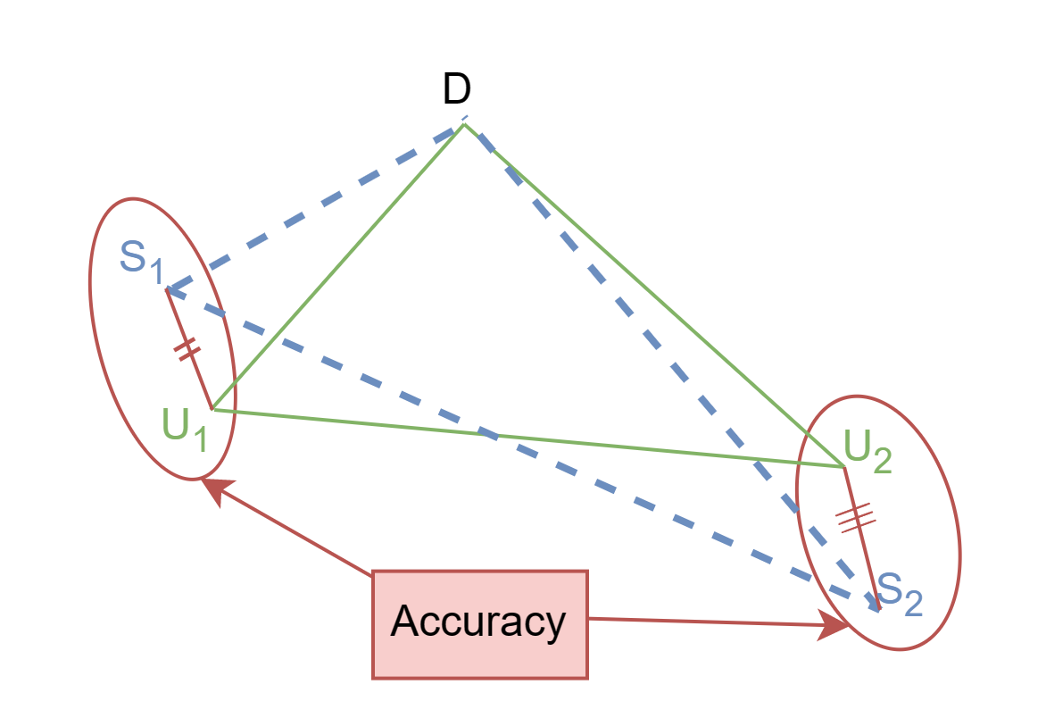
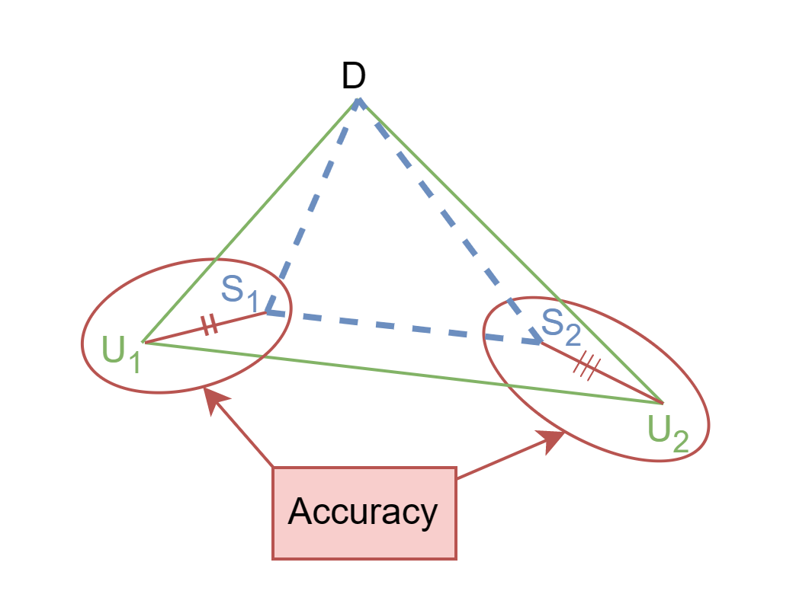
Accuracy-centric measure vs. Personalization-centric measure
Accuracy-centric measure : Difference between user written and model generated summary
Personalization-centric measure : Proportional differential in model-generated summary and user profile distances
(a) Accuracy is high, personalization is low
(b) Accuracy is high, personalization is high
Notes:
Things that we are focusing on: Difference in model generated summary proportional to difference in user profile (w.r.t. document)

Slide 10
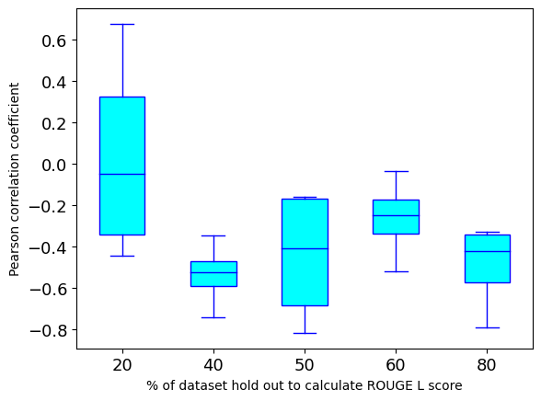
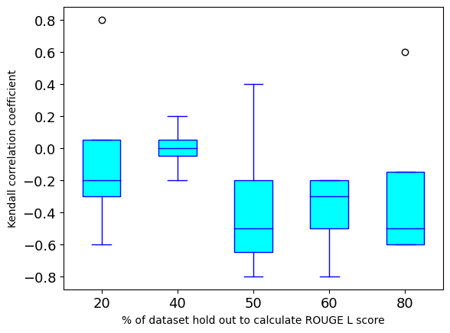
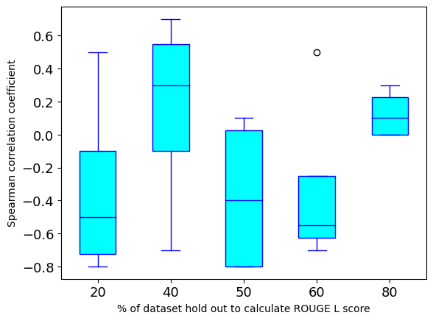
Accuracy measures are not adequate
Both +ve and -ve Correlation of e-DINS_{sub} with ROUGE L
Accuracy measures are not adequate for measuring degree of personalization

Slide 11
Designing evaluation measure
Effective Degree of Insensitivity (w.r.t subjectivity)

Slide 12
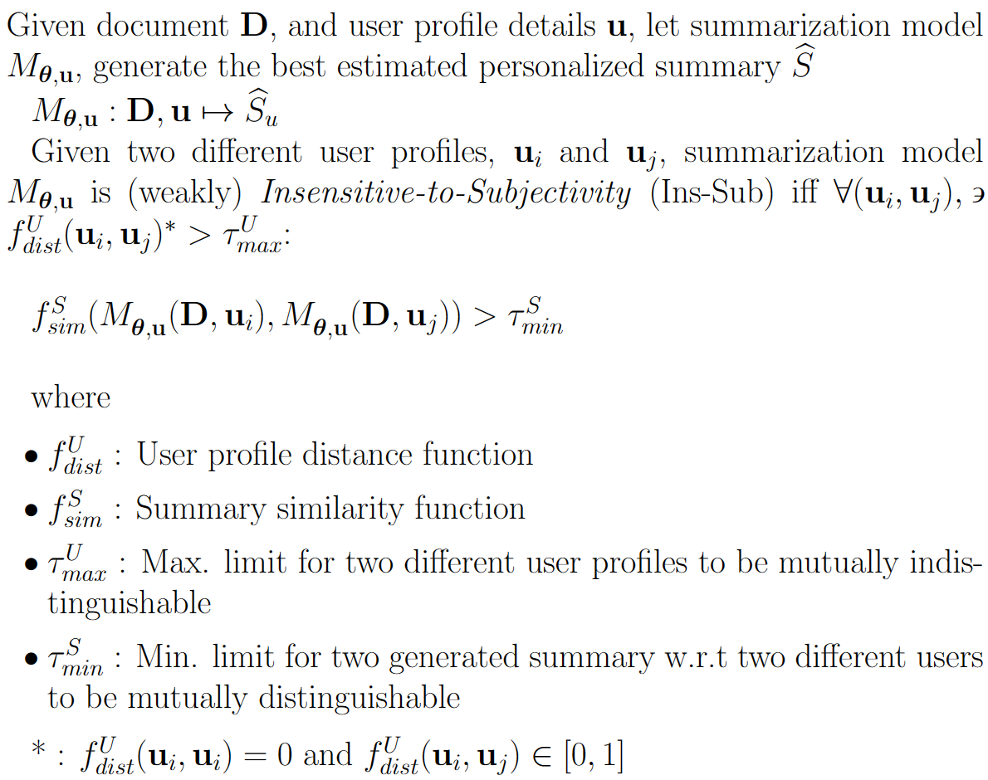
What is Insensitivity?
Notes:
Things that we are focusing on

Slide 13
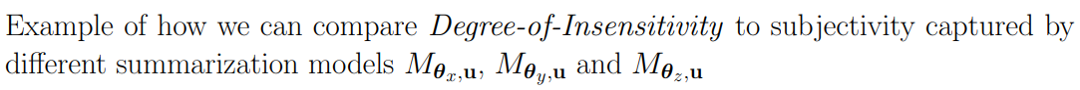
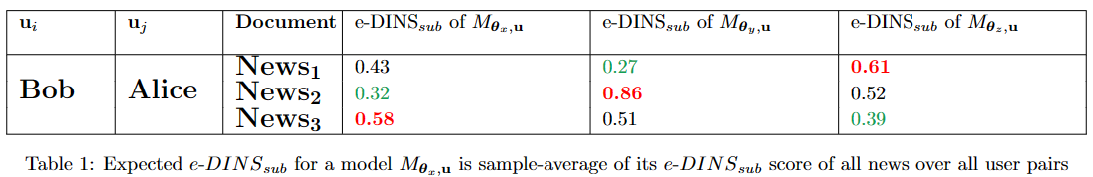
Degree of Insensitivity as a viable measure
Notes:
Things that we are focusing on

Slide 14
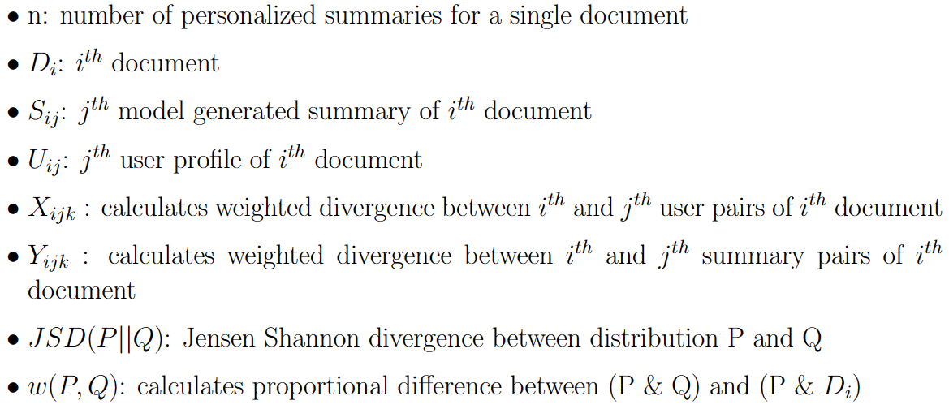
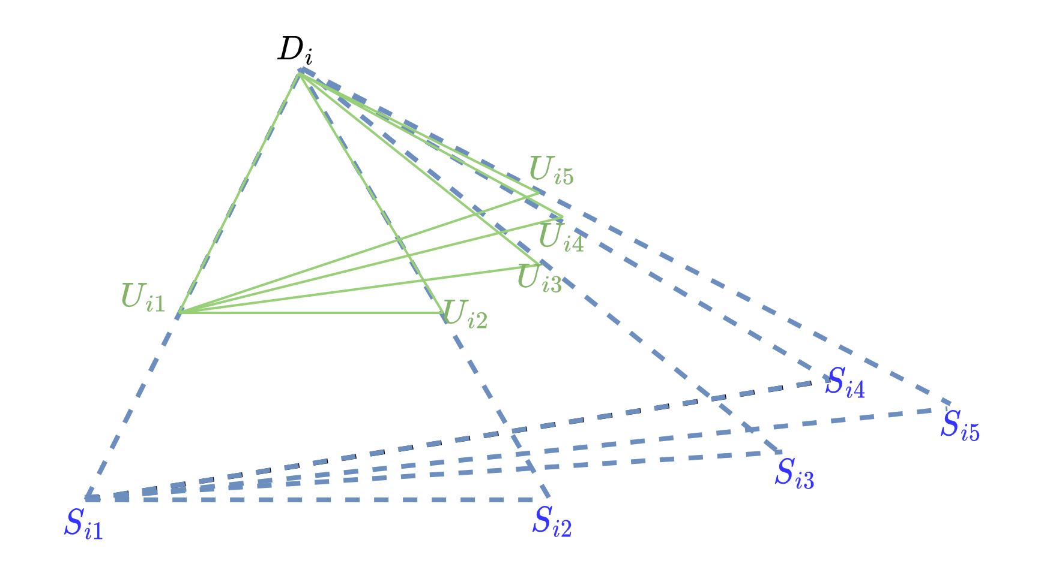
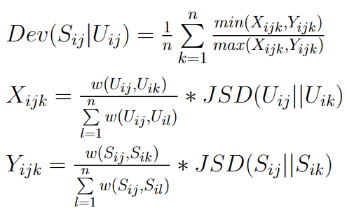

Deviation : Formulation
Deviation Dev(S_{ij} I U_{ij}) calculates proportional difference of summary S_{ij} (i.e. j^{th} summary of i^{th} document) and user profile U_{ij} (i.e. corresponding j^{th} User Profile for whom S_{ij} is generated by model) with rest of model-generated summaries and user profiles respectively
Notes:
how rest of summaries S_{j} deviates from S_{i}, weighted by deviation between S_{i} and S_{j} w.r.t. deviation between S_{i} and source document D

Slide 15
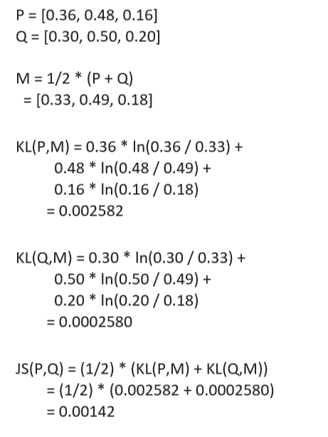


D-INS w.r.t subjectivity (D-INS_{sub}): Formulation
Jensen–Shannon divergence used to find deviation between two distributions.
Notes:
Things that we are focusing on

Slide 16

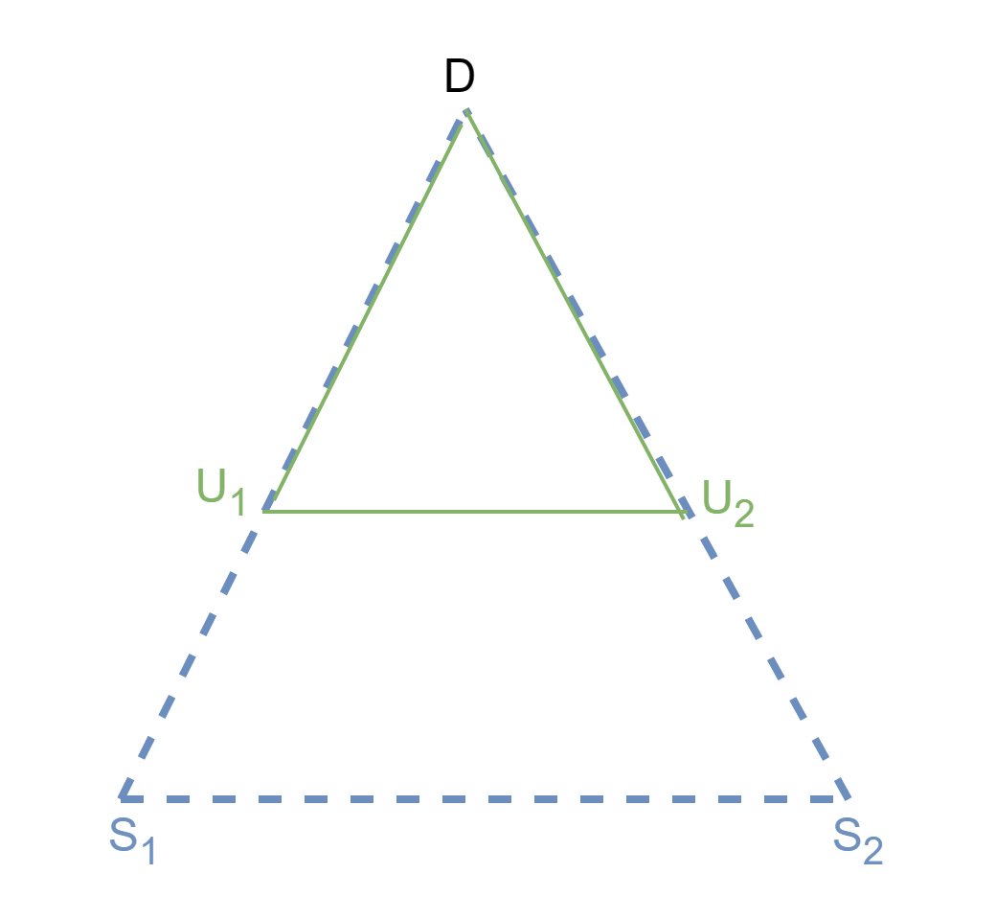
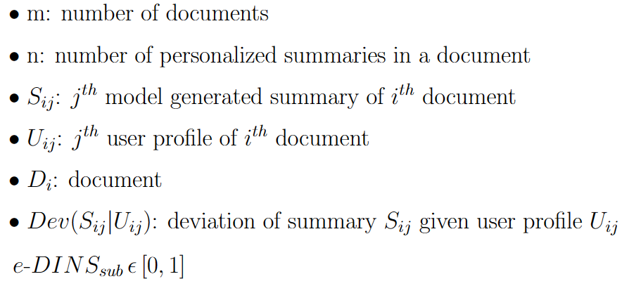
e-DINS w.r.t subjectivity (e-DINS_{sub}): Formulation
Effective Degree of Insensitivity w.r.t subjectivity e-DINS_{sub} evaluates performance of model based on how much summary deviate as per user profile
e-DINS_{sub} is high when summary pair doesn’t deviate as per user profile pair
This indicates model is highly insensitivy i.e. bad in capturing personalization
Notes:
Things that we are focusing on

Slide 17
Experimental Setup

Slide 18
Dataset: PENS (Test Data)
PENS(Personalized News headlineS) [3]
We used test data of PENS dataset that contains headlines.
Headlines can be considered as TLDR summary
For test: 103 English native speakers collected
Click behaviors
More than 20,000 manually-written personalized headlines of news articles, regarded as the gold standard of the user-preferred titles.
Test set created in 2 stages
1st: Each person browses 1,000 news headlines and marks at least 50 pieces he is interested in.
Headlines are randomly selected and were arranged by their first exposure time.
2nd: Write their preferred headlines for different 200 articles, without knowing at original news title.
these news articles are excluded from the 1st stage
Redundantly assign them to make sure each news is seen by 4 people on average.

Slide 19
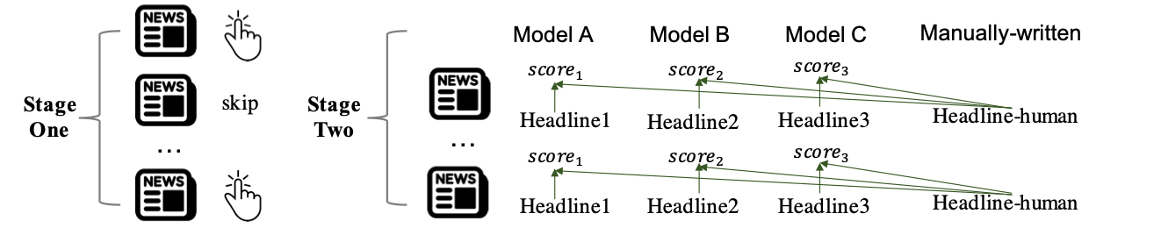
Dataset: PENS (Personalized News headlineS) (Test set)
Test set includes 3840 news article & prepared in 2 stages
1st: Each person browses 1,000 news headlines and marks at least 50 pieces he is interested in
2nd: Write their preferred headlines for 200 different articles, without knowing original news title
these news articles are excluded from the 1st stage
For each news, prefered headlines is written by 4 people on average
Notes:
1st: Each person browses 1,000 news headlines and marks at least 50 pieces he is interested in.
2nd: Write their preferred headlines for different 200 articles , without knowing at original news title.
these news articles are excluded from the 1st stage
Redundantly assign them to make sure each news is seen by 4 people on average.

Slide 20
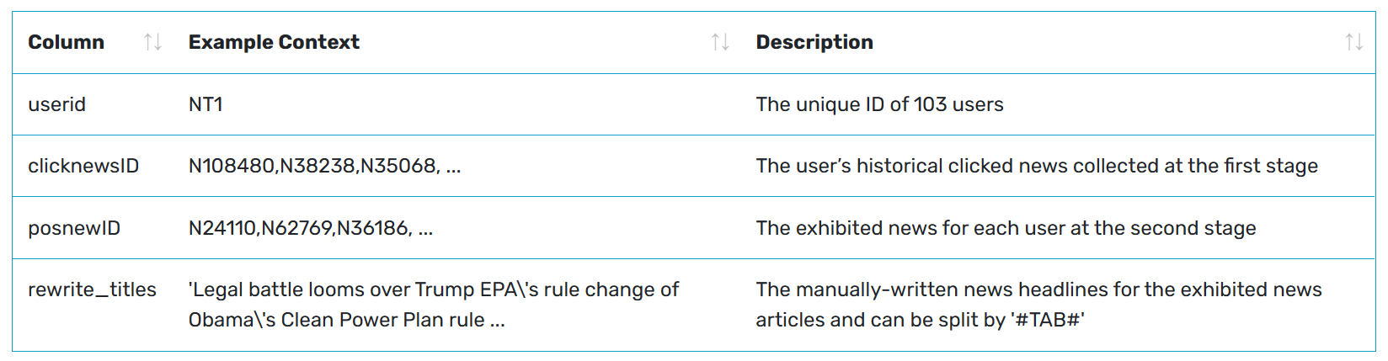
Dataset: PENS (Personalized News headlineS) (Test set)
Notes:
1st: Each person browses 1,000 news headlines and marks at least 50 pieces he is interested in.
2nd: Write their preferred headlines for different 200 articles , without knowing at original news title.
these news articles are excluded from the 1st stage
Redundantly assign them to make sure each news is seen by 4 people on average.

Slide 21
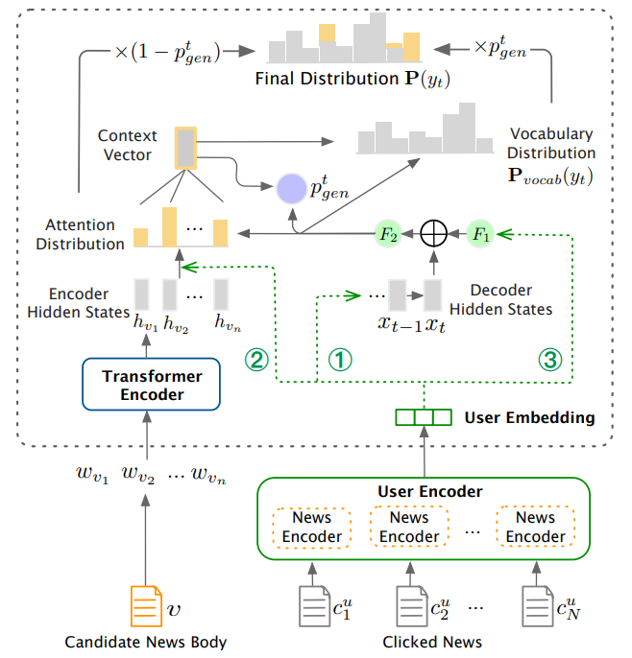
PENS Personalized Summarization model [ACL; 2021]
Training process
Pointer-Generator Network trained on actual headline
Further, policy model optimized on reward of generated headline
reward considers degree of personalization, fluency and factualness.
Three ways to inject user embedding
To initialize decoder’s hidden state of the headline generator
To personalize attentive values on words in news body
To affect choice between generation and copying
Framework of personalized news headline generation [3]

Slide 22
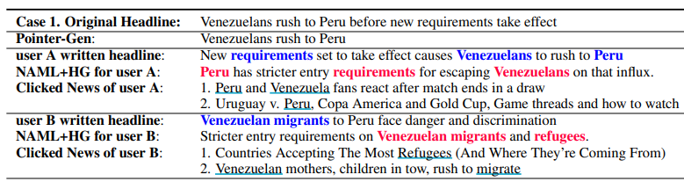
Example of personalized summary (headline) generation
Underlined words and colored words represent the correlated words in the manually-written headlines, clicked news, and the generated headlines, respectively.

Slide 23
Computing e-D-INS using human gold reference summaries from PENS
To find divergence we need distribution of model generated personalized summaries and user profiles
Based on word count distribution of model summaries created
Distribution of the user-written personalized summary is used as the user profile
The keywords that would be included in the summary are the ones that the user is most interested in with regards to the article.

Slide 24
Computing e-DINS using user-written reference summaries from PENS Dataset
Document: red cat on red tall table ⇒ Preprocessing ⇒ [red, cat, red, tall, table]
User-written Summary: cat on table ⇒ Preprocessing ⇒ [cat, table]
Model Summary: red cat on desk (OOV) ⇒ Preprocessing ⇒ [red, cat, desk]
Vocab | Doc distribution | User summary distribution | Model summary distribution
 | ratio = word count in doc / total number of words in doc | ratio of word in user summary / ratio of word in doc | ratio of word in model summary / ratio of word in doc
red | 2/5 = 0.4 | 0 (absent) | (1/3) / (1/5) = 1.66
cat | 1/5 = 0.2 | (1/2) / (1/5) = 2.5 | (1/3) / (1/5) = 1.66
tall | 1/5 = 0.2 | 0 (absent) | 0 (absent)
table | 1/5 = 0.2 | (1/2) / (1/5) = 2.5 | 0 (absent)
desk | 0 (absent) | 0 (absent) | (1/3) / ? = ? (OOV)

Slide 25
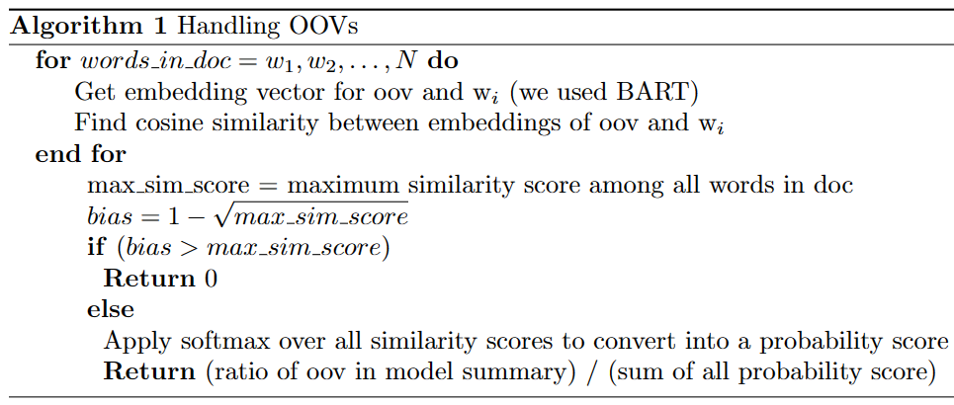
Handling Out-Of-Vocabulary(OOV) words in reference summary - An example
Words in doc | Similarity of each word in doc with “desk” | Softmax
red | 0.537 | 0.2
cat | 0.405 | 0.175
tall | 0.613 | 0.216
table | 0.892 | 0.285
bias | 1 - (0.89)^{1/2} = 0.056 | 0.124
Vocab | Model summary distribution
 | ratio of word in model summary / ratio of word in doc
red | (1/3) / (1/5) = 1.66
cat | (1/3) / (1/5) = 1.66
tall | 0 (absent)
table | 0 (absent)
desk (OOV) | (1/3) / 0.876 = 0.381
Probability of having “desk” in doc
0.876

Slide 26
Degree of personalization of SOTA personalized summarizers (PENS models)

Slide 27
Personalization vs. Accuracy w.r.t user profiles models
User embedding used in PENS | User embedding injection type | e-DINS_{sub} | ROUGE 1 | ROUGE 2 | ROUGE L
NAML [8] | 1 | 0.89908 | 27.49 | 10.14 | 21.62
NRMS [5] | 1 | 0.91642 | 26.15 | 9.37 | 21.03
EBNR [6] | 1 | 0.95308 | 25.13 | 9.03 | 20.73
EBNR [6] | 2 | 0.99513 | 25.49 | 9.14 | 20.82
NT: ROUGE scores are w.r.t user-written extreme summaries (i.e. headlines) in PENS dataset
Notes:
26.15, 9.37, 21.03

Slide 28
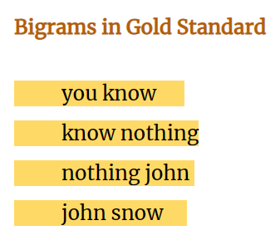
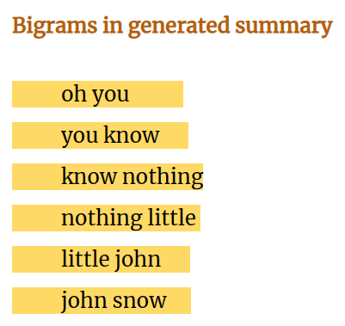
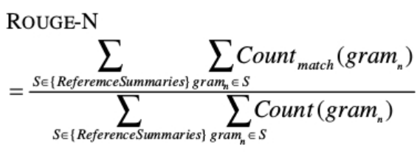

ROUGE : Recall-Oriented Understudy for Gisting Evaluation
Notes:
Things that we are focusing on

Slide 29
Reliability of e-DINS_{sub} as a degree of personalization measure

Slide 30
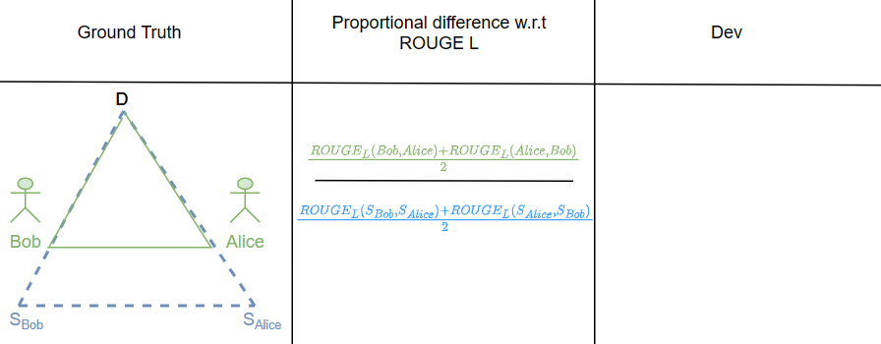
Indirect e-DINS robustness evaluation (using ROUGE L)
Dev(S_{Bob} |Bob) + Dev(S_{Alice} |Alice)
2
ROUGE score is a widely used metric with a high correlation with human judgment compared to other measures of accuracy [2]

Slide 31
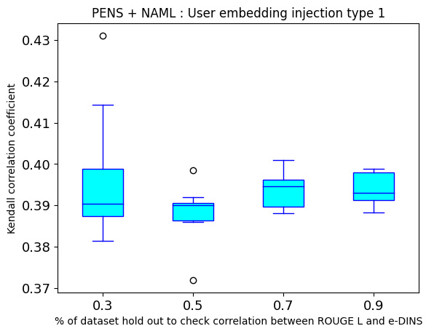
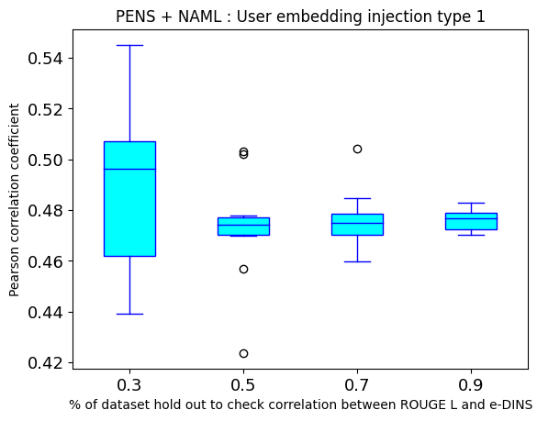
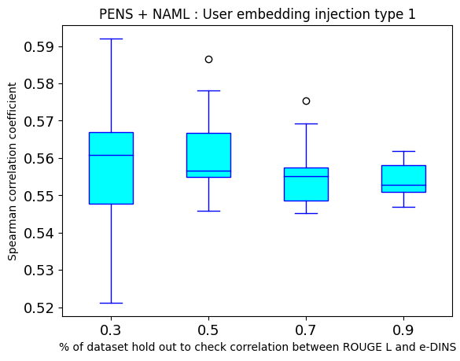
Reliability of e-DINS_{sub} as a degree of personalization measure
Notes:
26.15, 9.37, 21.03

Slide 32
Future Work & Work-in-progress

Slide 33
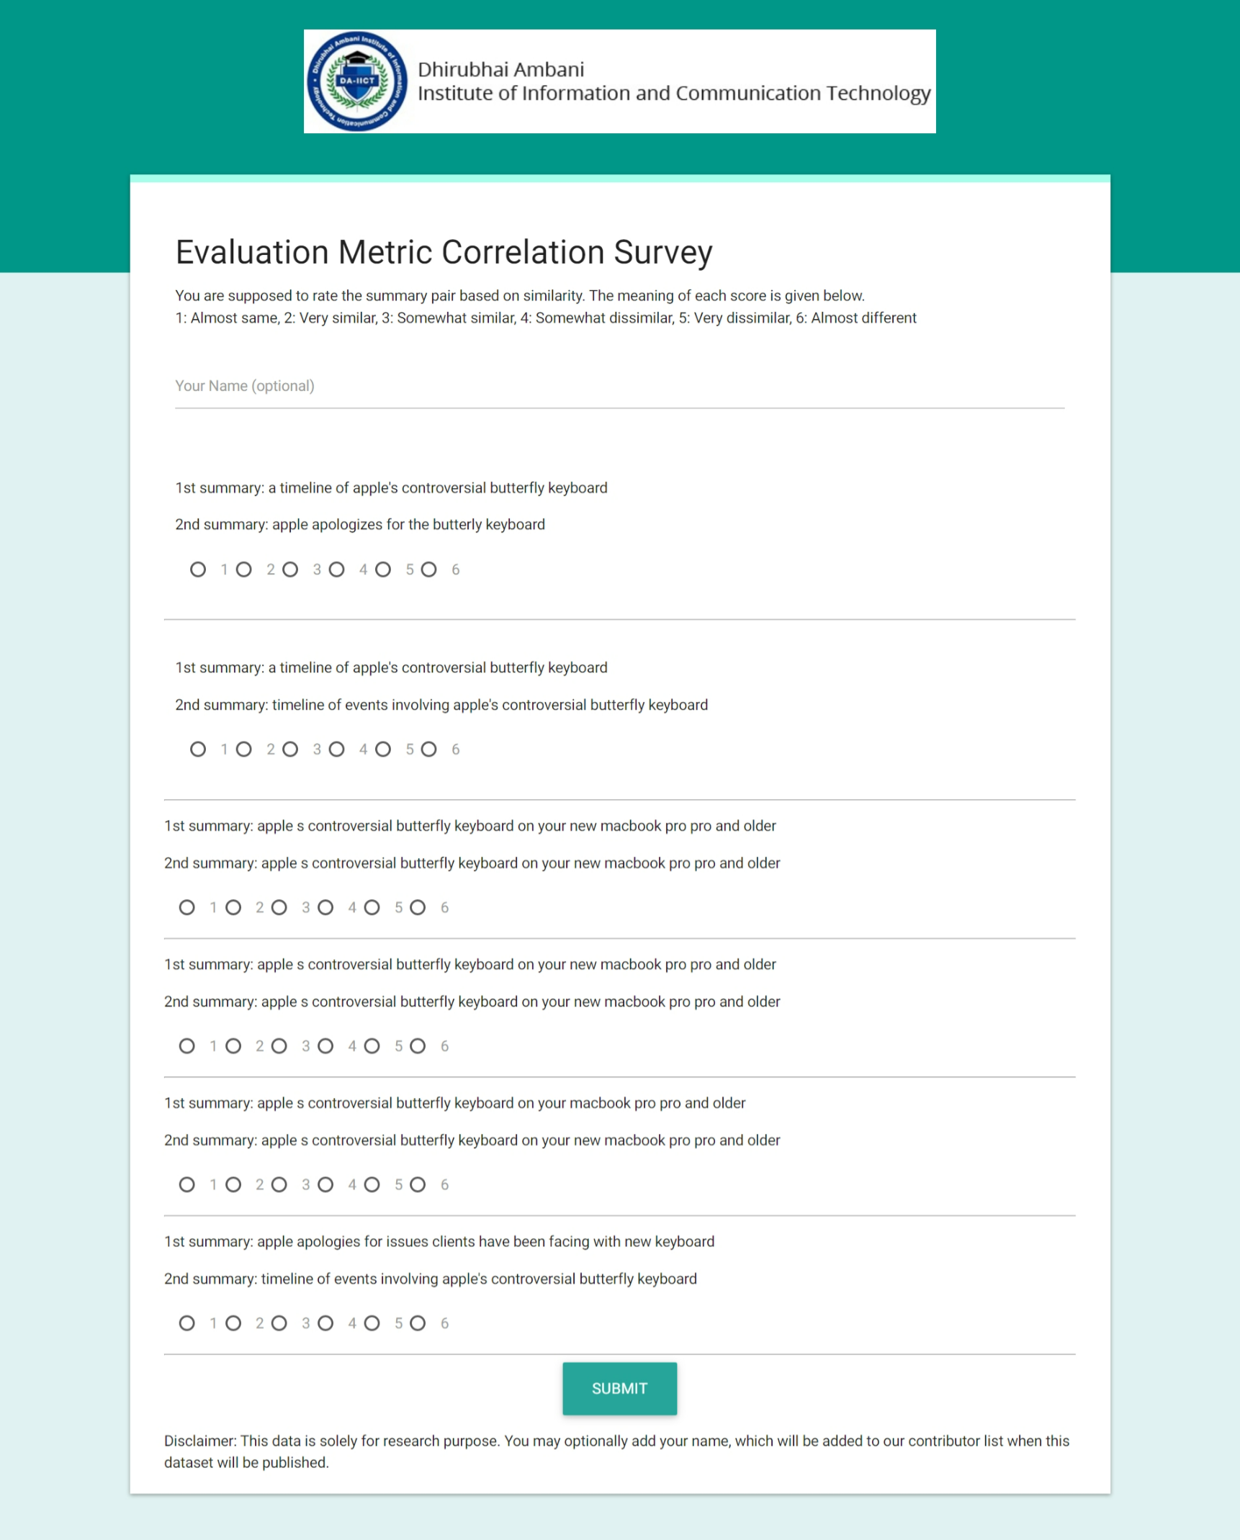
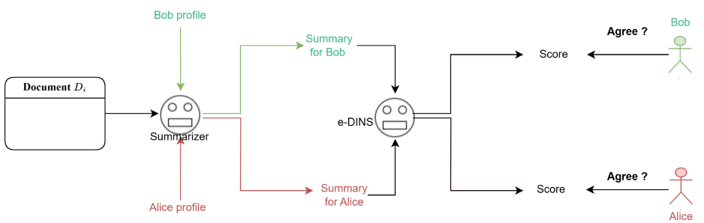
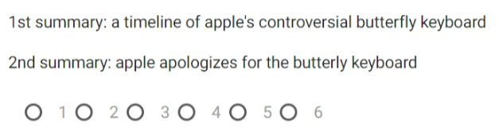
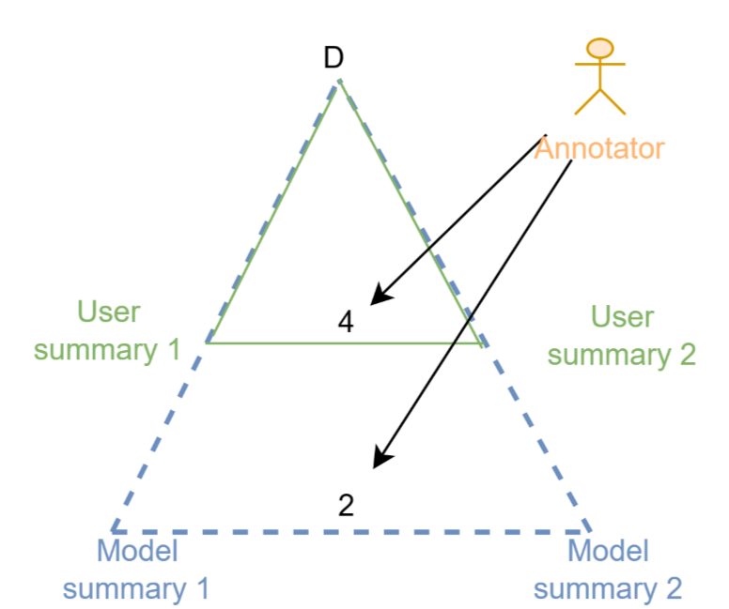
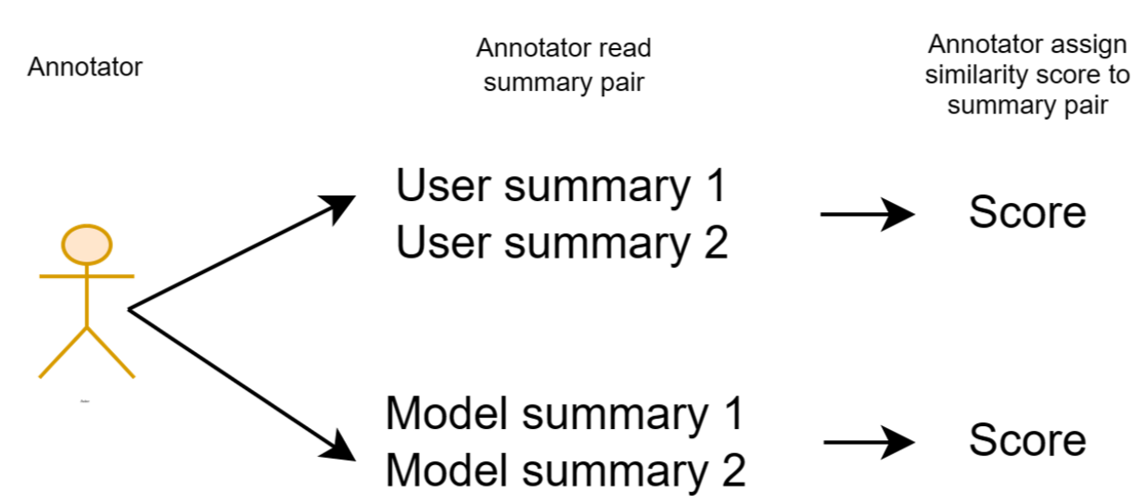
Ongoing: Direct e-DINS robustness evaluation
Notes:
Things that we are focusing on

Slide 34
Future work (Order-wise)
Evaluating ChatGPT-styled models’ degree of personalization w.r.t summarization [work-in-progress]
Incorporate e-DINS into stable contemporary accuracy measures (e.g.: ROUGE, BLUE, METEOR, BertScore, etc.)
Exploring SOTA High-Dimensional Contextual Vector based e-DINS measures (instead of JSD) for measuring of personalization
Proposing our own e-DINS based accuracy measure and comparison with other standard measures
Notes:
Things that we are focusing on

Slide 35
Reference
Daniel O et.al.; A comprehensive review of automatic text summarization techniques: method, data, evaluation and coding; arXiv; 2023
Tianyi Zhang et. al.; Benchmarking Large Language Models for News Summarization; arXiv; 2023
Xiang Ao et. al.; PENS: A Dataset and Generic Framework for Personalized News Headline Generation; IJCNLP; 2021
Mike Lewis et. al.; BART: Denoising Sequence-to-Sequence Pre-training for Natural Language Generation, Translation, and Comprehension; Association for Computational Linguistics, 2019

Slide 36
Reference
C. Wu et. al.; Neural news recommendation with multi-head self- attention; EMNLP; 2019
S. Okura et. al.; Embedding-based news recommendation for millions of users; KDD; 2017
A. See et. al.; Get to the point: Summarization with pointer-generator networks; arXiv; 2017
C. Wu et. al.; Neural news recommendation with attentive multi-view learning; arXiv; 2019

Slide 37
Thank you

